Slide 1
Chapter 8
Accounting for Receivables
(應收款項會計)
Instructor: Chih-Liang Julian Liu
Department of Industrial and Business Management
Chang Gung University

Slide 2
Main Concept
What’s Receivables?
Valuation:
Collection of Receivables
Cash

Slide 3
Accounting for Receivables
Types of Receivables
Accounts Receivable
Notes Receivable
Statement Presentation and Analysis
Accounts receivable
Notes receivable
Other receivables
Recognizing accounts receivable
Valuing accounts receivable
Disposing of accounts receivable
Determining maturity date
Computing interest
Recognizing notes receivable
Valuing notes receivable
Disposing of notes receivable
Presentation
Analysis

Slide 4

Types of Receivables
Amounts due from individuals and other companies that are expected to be collected in cash.
Amounts owed by customers that result from the sale of goods and services.
Written promise (as evidenced by a formal instrument; 正式書面工具 ) for amounts to be received.
“Nontrade” (interest, loans to officers, advances to employees (代墊員工款), and income taxes refundable).
Accounts Receivable
Notes Receivable
Other Receivables

Slide 5
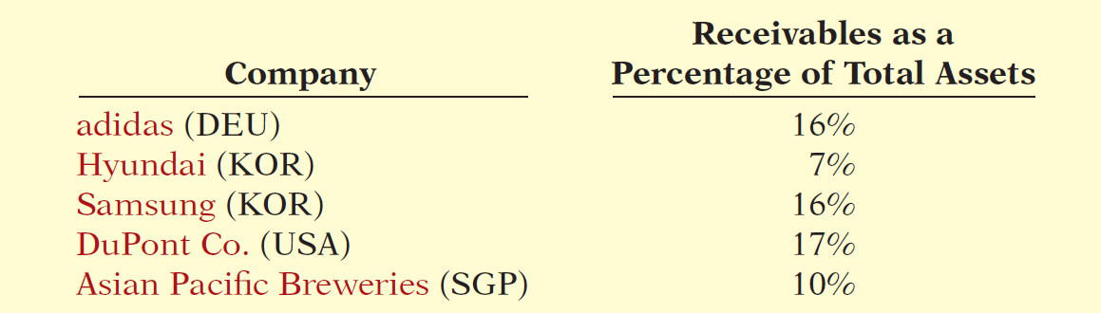
Types of Receivables
Amounts due from individuals and other companies that are expected to be collected in cash.
Illustration 8-1

Slide 6
Accounts Receivable
Three accounting issues:
  Recognizing (認列) accounts receivable.
  Valuing (評價) accounts receivable.
  Disposing (處分) of accounts receivable.
Recognizing Accounts Receivable
Service organization - records a receivable when it provides service on account.
Merchandiser - records accounts receivable at the point of sale of merchandise on account.

Slide 7
Accounts Receivable
Illustration: Assume that Hennes & Mauritz (SWE) on July 1, 2014, sells merchandise on account to Polo Company for $1,000 terms 2/10, n/30. Prepare the journal entry to record this transaction on the books of Hennes & Mauritz.
Jul. 1
Accounts Receivable 1,000
Sales Revenue 1,000

Slide 8
Accounts Receivable
Illustration: On July 5, Polo returns merchandise worth $100 to Hennes & Mauritz (SWE).
Jul. 5
Sales Returns and Allowances 100
Accounts Receivable 100
On July 11, Hennes & Mauritz receives payment from Polo Company for the balance due.
Jul. 11
Cash 882
Sales Discounts ($900 x .02) 18
Accounts Receivable 900

Slide 9
Accounts Receivable
Illustration: Some retailers issue their own credit cards. Assume that you use your JCPenney (USA) credit card to purchase clothing with a sales price of $300.
Accounts Receivable 300
Sales Revenue 300
Assuming that you owe $300 at the end of the month, and JCPenney charges 1.5% per month on the balance due
Accounts Receivable 4.50
Interest Revenue ($300 x 1.5%) 4.50

Slide 10
Accounts Receivable
Valuing Accounts Receivable
  Current asset on S/FP .
  Valuation (net realizable value; 淨變現值).
Uncollectible Accounts Receivable
  Sales on account raise the possibility of accounts not being collected.
  Seller records losses that result from extending credit as Bad Debt Expense (壞帳費用).

Slide 11
Accounts Receivable
Methods of Accounting for Uncollectible Accounts
Direct Write-Off
(直接沖銷法)
Theoretically undesirable:
  No matching.
  Receivable not stated at cash realizable value.
  Not acceptable for financial reporting.
Allowance Method
(備抵法)
Losses are estimated:
  Better matching.
  Receivable stated at cash realizable value.
  Required by IFRS.

Slide 12
Accounts Receivable
Direct Write-off Method for Uncollectible Accounts
Illustration: Assume that Warden Co. writes off (沖銷) M. E. Doran’s HK$1,600 balance as uncollectible on December 12. Warden’s entry is:
Bad Debt Expense (I/S) 1,600
Accounts Receivable 1,600
Theoretically undesirable:
  No matching.
  Receivable not stated at cash realizable value.
  Not acceptable for financial reporting.

Slide 13
Accounts Receivable
Allowance Method for Uncollectible Accounts
Companies estimate uncollectible accounts receivable at the end of each period.
Debit Bad Debt Expense (壞帳費用) and credit Allowance for Doubtful Accounts (備抵壞帳) (a contra-asset account).
Bad Debt Expense xxx
  Allowance for Doubtful Accounts xxx

Slide 14
Accounts Receivable
Allowance Method for Uncollectible Accounts
Companies debit Allowance for Doubtful Accounts and credit Accounts Receivable at the time the specific account is written off (沖銷) as uncollectible.
Allowance for Doubtful Accounts xxx
  Accounts Receivable xxx

Slide 15
Accounts Receivable
Illustration: Hampson Furniture has credit sales of €1,200,000 in 2014, of which €200,000 remains uncollected at December 31. The credit manager estimates that €12,000 of these sales will prove uncollectible.
Dec. 31
Bad Debt Expense 12,000
Allowance for Doubtful Accounts 12,000

Slide 16
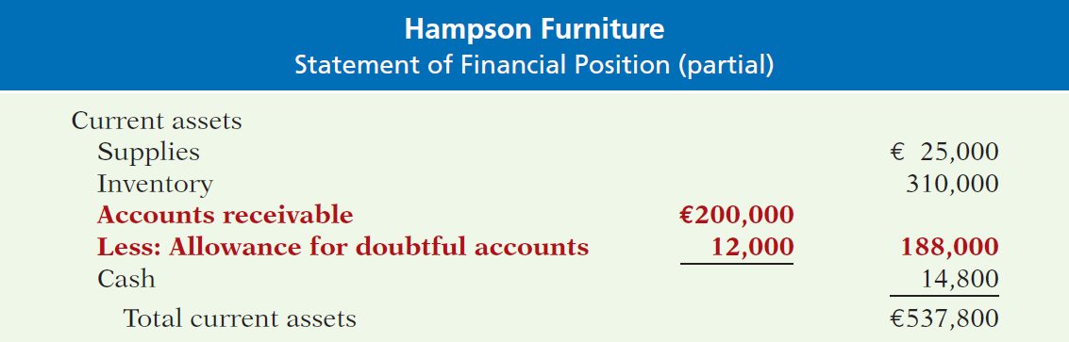
Accounts Receivable
Illustration 8-3 Presentation of allowance for doubtful accounts
Contra account (應收帳款減項)
Cash Realizable Value of A/R
(應收帳款淨變現價值)

Slide 17
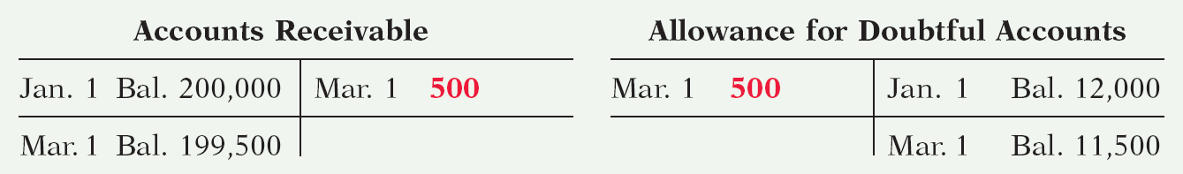
Accounts Receivable
Recording Write-Off of an Uncollectible Account
Illustration: The financial vice-president of Hampson Furniture authorizes a write-off of the €500 balance owed by R. A. Ware on March 1, 2015. The entry to record the write-off is:
Mar. 1
Allowance for Doubtful Accounts 500
Accounts Receivable 500
Illustration 8-4

Slide 18

Accounts Receivable
Recording the Write-Off of an Uncollectible Account:
The write-off affects only statement of financial position accounts.
Illustration 8-5

Slide 19
Accounts Receivable
Recovery of an Uncollectible Account
Illustration: On July 1, R. A. Ware pays the €500 amount that Hampson had written off on March 1. Hampson makes these entries:
July 1
Accounts Receivable 500
Allowance for Doubtful Accounts 500
1
Cash 500
Accounts Receivable 500

Slide 20
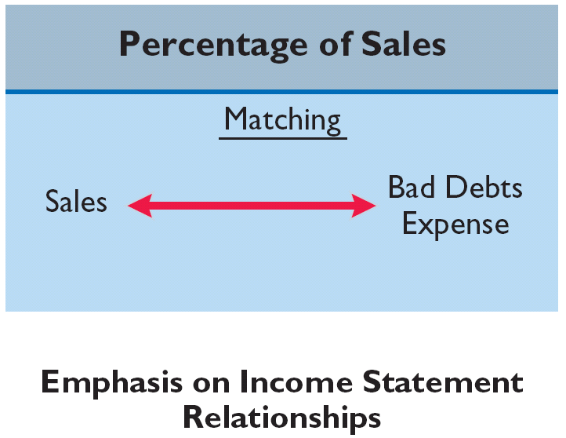
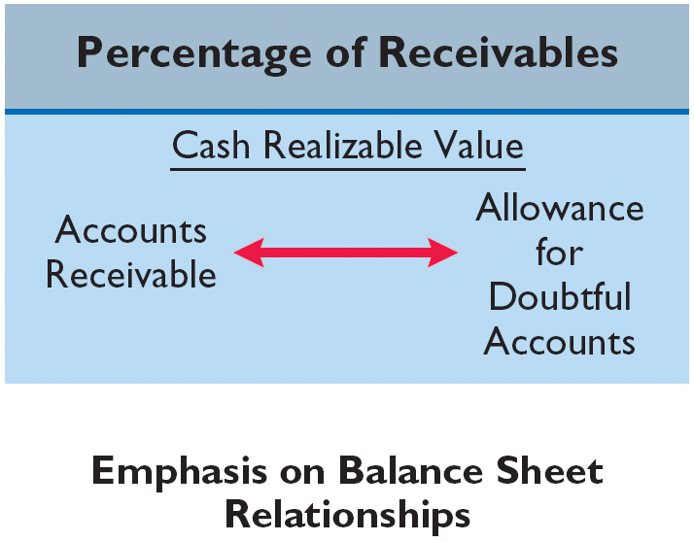
Accounts Receivable
Estimating the Allowance
Illustration 8-6
Emphasis on Income Statement Relationships
Emphasis on Statement of Financial Position Relationships

Slide 21
Accounts Receivable
Estimating the Allowance
Illustration 8-6
Management estimates what percentage of credit sales (賒銷) will be uncollectible. This percentage is based on past experience and anticipated credit policy.
Emphasis on Income Statement Relationships

Slide 22
Accounts Receivable
Percentage-of-Sales (銷貨百分比法)
Illustration: Assume that Gonzalez Company elects to use
the percentage-of-sales basis. It concludes that 1% of net credit sales (賒銷淨額) will become uncollectible. If net credit sales for 2014 are €800,000, the adjusting entry is:
*
Dec. 31
Bad Debt Expense 8,000
Allowance for Doubtful Accounts 8,000
* €800,000 x 1%

Slide 23
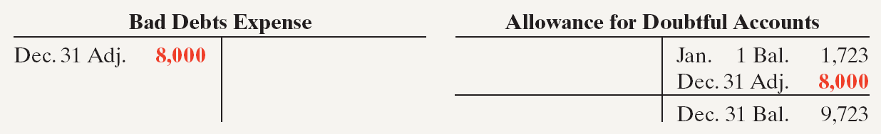
Accounts Receivable
Percentage-of-Sales
  Emphasizes matching of expenses with revenues.
  Adjusting entry to record bad debts disregards the existing balance in Allowance for Doubtful Accounts.
Illustration 8-7

Slide 24
Accounts Receivable
Estimating the Allowance
Illustration 8-6
Management establishes a percentage relationship between the amount of receivables and expected losses from uncollectible accounts.
Emphasis on Statement of Financial Position Relationships

Slide 25
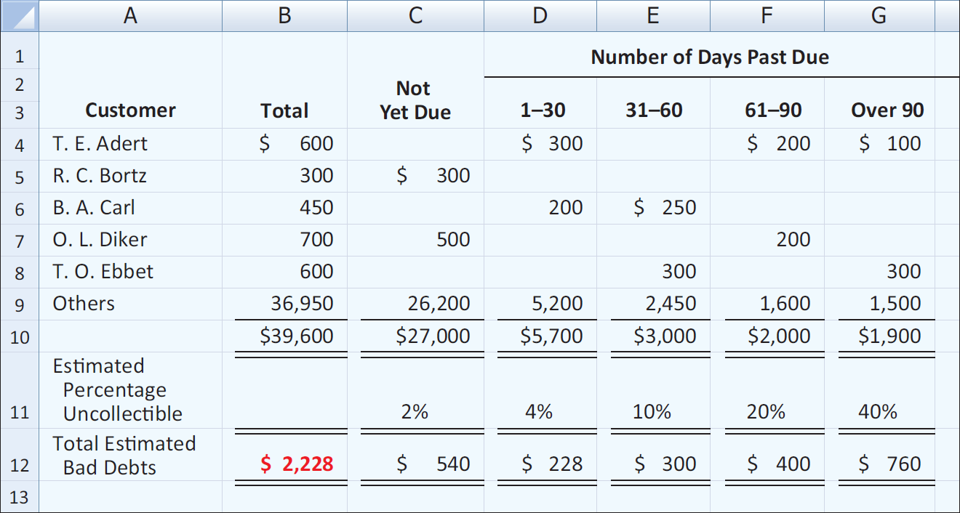
Accounts Receivable
Aging the accounts receivable (應收帳款帳齡) - customer balances are classified by the length of time they have been unpaid.
Illustration 8-8

Slide 26
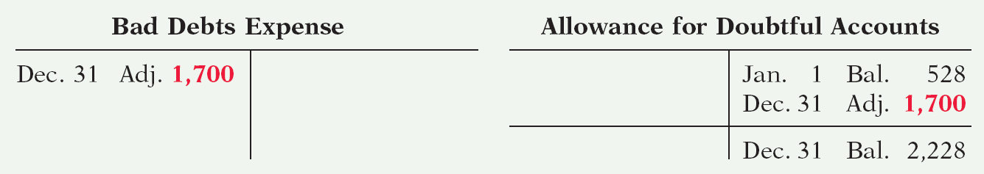
Accounts Receivable
Estimating the Allowance
Illustration: Assume the unadjusted trial balance shows Allowance for Doubtful Accounts with a credit balance of $528. Prepare the adjusting entry assuming $2,228 is the estimate of uncollectible receivables from the aging schedule.
Dec. 31
Bad Debt Expense 1,700
Allowance for Doubtful Accounts 1,700
Illustration 8-9

Slide 27
Accounts Receivable
Estimating the Allowance
Illustration: Assume the unadjusted trial balance shows Allowance for Doubtful Accounts with a debit balance of $528. Prepare the adjusting entry assuming $2,228 is the estimate of uncollectible receivables from the aging schedule.
Dec. 31
Bad Debt Expense 2,728
Allowance for Doubtful Accounts 2,728

Slide 28
Debt balance (Allowance account)
Allowance for Doubtful Accounts
Bad Debt Expense
Bal. $528
Dec. 31 Adj. 2,728
Dec. 31 Adj. 2,728
Dec. 31 Bal. 2,228

Slide 29
Brule Co. has been in business five years. The ledger at the end of the current year shows:
Accounts Receivable $30,000 Dr.
Sales Revenue $180,000 Cr.
Allowance for Doubtful Accounts $2,000 Dr.
Bad debts are estimated to be 10% of receivables. Prepare the entry to adjust Allowance for Doubtful Accounts.

Slide 30
Brule Co. has been in business five years. The ledger at the end of the current year shows:
Accounts Receivable $30,000 Dr.
Sales Revenue $180,000 Cr.
Allowance for Doubtful Accounts $2,000 Dr.
Bad debts are estimated to be 10% of receivables. Prepare the entry to adjust Allowance for Doubtful Accounts.
Solution:
Bad Debt Expense 5,000
*
Allowance for Doubtful Accounts 5,000
* [(0.1 x $30,000) + $2,000]

Slide 31
Accounts Receivable
Disposing (處分) of Accounts Receivable
Companies sell receivables for two major reasons.
  Receivables may be the only reasonable source of cash.
  Billing and collection are often time-consuming and costly.

Slide 32
Sale of Receivables
Customer
Account Receivable
Account Receivable
Selling account receivable
Company
Factor
(Bank)
Cash
Charges a commission fee (1-3%)

Slide 33
Accounts Receivable
Sale of Receivables
Factor (應收帳款管理公司)
  Finance company or bank.
  Buys receivables from businesses and then collects the payments directly from the customers.
  Typically charges a commission to the company that is selling the receivables.
  Fee ranges from 1-3% of the receivables purchased.

Slide 34
Accounts Receivable
Illustration: Assume that Tsai Furniture factors
NT$600,000 of receivables to Federal Factors. Federal Factors assesses a service charge of 2% of the amount of receivables sold. The journal entry to record the sale by Tsai Furniture is as follows.
Cash 588,000
Service Charge Expense (I/S) 12,000
Accounts Receivable 600,000
(NT$600,000 x 2% = NT$12,000)

Slide 35
Accounts Receivable
Credit Card Sales(信用卡銷貨):
  Visa, MasterCard, American Express
  Recorded the same as cash sales.
  Retailer pays card issuer a fee of 2 to 6% for processing the transactions.

Slide 36

Advantages of Credit Cards

Slide 37
Accounts Receivable
Illustration: Lee Co. purchases NT$6,000 of music downloads for its restaurant from Yang Music Co., using a Visa First Bank Card. First Bank charges a service fee of 3%. The entry to record this transaction by Yang Music is as follows.
Cash 5,820
Service Charge Expense 180
Sales Revenue 6,000

Slide 38
Notes Receivable (應收票據)
Companies may grant credit in exchange for a promissory note (本票). A promissory note is a written promise to pay a specified amount of money on demand or at a definite time.
Promissory notes may be used
  when individuals and companies lend or borrow money,
  when amount of transaction and credit period exceed normal limits, or
  in settlement of accounts receivable.

Slide 39
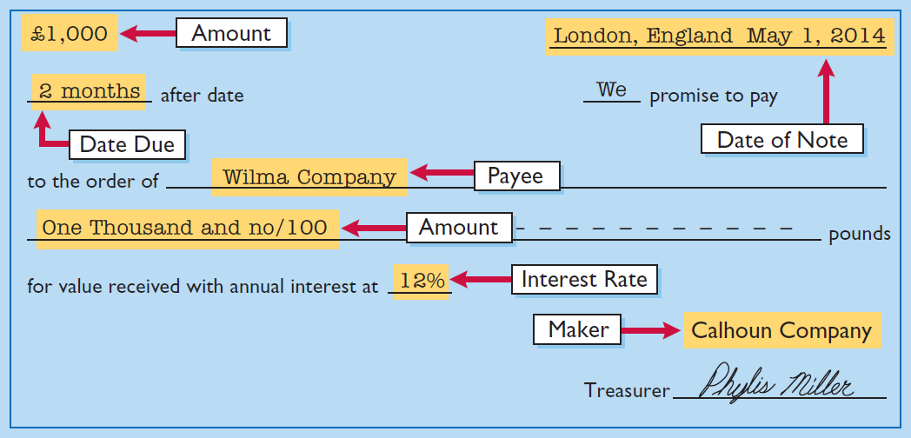
Notes Receivable
To the Payee (受款人), the promissory note is a note receivable. To the Maker (開票人), the promissory note is a note payable.
Illustration 8-11

Slide 40

Notes Receivable
Determining the Maturity Date (到期日)
Note expressed in terms of
  Months
  Days
When counting days, omit the date the note is issued, but include the due date (算尾不算頭).

Slide 41

Notes Receivable
Computing Interest
Illustration 8-14

Slide 42
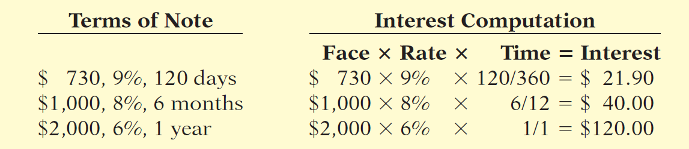
Notes Receivable
Illustration 8-15

Slide 43
Notes Receivable
Recognizing Notes Receivable
Illustration: Calhoun Company wrote a ₤1,000, two-month, 12% promissory note dated May 1, to settle an open account. Prepare entry would Wilma Company makes for the receipt of the note.
May 1
Notes Receivable 1,000
Accounts Receivable 1,000

Slide 44
Notes Receivable
Valuing Notes Receivable
Report short-term notes receivable at their cash (net) realizable value.
Estimation of cash realizable value and bad debts expense are done similarly to accounts receivable.
Allowance for Doubtful Accounts is used.

Slide 45
Notes Receivable
Disposing of Notes Receivable
Notes may be held to their maturity date (到期日). (face value plus accrued interest)
Maker may default and payee must make an adjustment to the account.
Holder speeds up conversion to cash by selling the note receivable.

Slide 46
Notes Receivable
Disposing of Notes Receivable
Honor of Notes Receivable (應收票據到期兌現)
Maker pays it in full at its maturity date.
Dishonor of Notes Receivable (應收票據到期不兌現 )
Not paid in full at maturity.
No longer negotiable.

Slide 47
Notes Receivable
Honor of Notes Receivable
Illustration: Wolder Co. lends Higley Co. €10,000 on June 1, accepting a five-month, 9% interest note. If Wolder presents the note to Higley Co. on November 1, the maturity date, Wolder’s entry to record the collection is:
Nov. 1
Cash 10,375
Notes Receivable 10,000
Interest Revenue 375
(€10,000 x 9% x 5/12 = € 375)

Slide 48
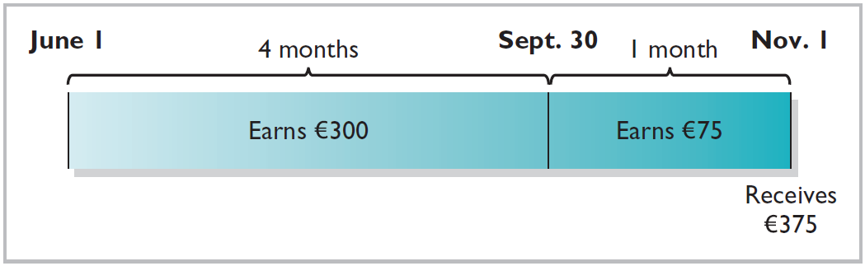
Notes Receivable
Accrual of Interest Receivable
Illustration: Suppose instead that Wolder Co. prepares financial statements as of September 30. The adjusting entry by Wolder is for four months ending Sept. 30.
Illustration 8-16
Sept. 1
Interest Receivable 300
Interest Revenue 300
(€10,000 x 9% x 4/12 = € 300)

Slide 49
Notes Receivable
Accrual of Interest Receivable
Illustration: Prepare the entry Wolder’s would make to record the honoring of the Higley note on November 1.
Nov. 1
Cash 10,375
Notes Receivable 10,000
Interest Receivable 300
Interest Revenue 75

Slide 50
Notes Receivable
Dishonor of Notes Receivable
Illustration: Assume that Higley Co. on November 1 indicates that it cannot pay at the present time. If Wolder Co. does expect eventual collection, it would make the following entry at the time the note is dishonored (assuming no previous accrual of interest).
Nov. 1
Accounts Receivable 10,375
Notes Receivable 10,000
Interest Revenue 375

Slide 51
Statement Presentation and Analysis
Presentation
Identify in the statement of financial position or in the notes each major type of receivable.
Report short-term receivables as current assets.
Report both gross amount of receivables and allowance for doubtful account.
Report bad debt expense and service charge expense as selling expenses.
Report interest revenue under “Other income and expense.”
SFP
IS

Slide 52
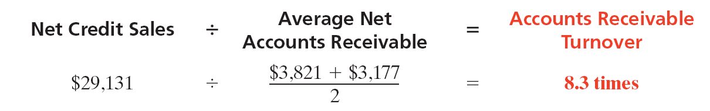
Statement Presentation and Analysis
Analysis
Illustration: In a recent year Lenovo Group (CHN) had net sales of $14,901 million for the year. It had a beginning accounts receivable (net) balance of $861million and an ending accounts receivable (net) balance of $728 million. Assuming that Lenovo’s sales were all on credit, its accounts receivable turnover ratio is computed as follows.
Illustration 8-17
$861 + $728
$14,901
÷
=
18.8 times
2

Slide 53

Statement Presentation and Analysis
Analysis
Illustration: Variant of the accounts receivable turnover ratio is average collection period in terms of days.
Illustration 8-17
$861 + $728
$14,901
÷
=
18.8 times
2
Illustration 8-18
365 days
÷
18.8 times
=
19.4 days

